Slide 1
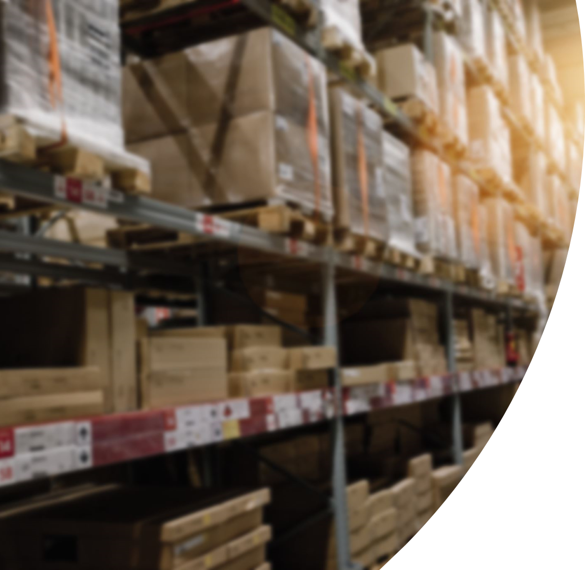
Inventory Management

Slide 2

Inventory
An inventory is a stock of goods
Different kinds of inventories
Raw materials and purchased parts
Work in process
Finished goods

Slide 3


Functions of Inventory
  To meet anticipated customer demand
  To smooth production requirements
  To protect against stockouts
  To take advantage of order cycles
  To take advantage of quantity discounts
  To permit operations

Slide 4
Requirements for effective inventory management
  A system to keep track of the inventory on hand and on order
  A reliable forecast of demand that includes an indication of possible forecast error
  Knowledge of lead times and lead time variability
  Reasonable estimates of inventory holding costs, ordering costs, and shortage costs
  A classification system for inventory items

Slide 5

Inventory Turnover
= Annual cost of goods sold / Average inventory investment
The turnover ratio indicates how many times a year the inventory is sold
The higher the ratio, the better, because that implies more efficient use of inventories

Slide 6

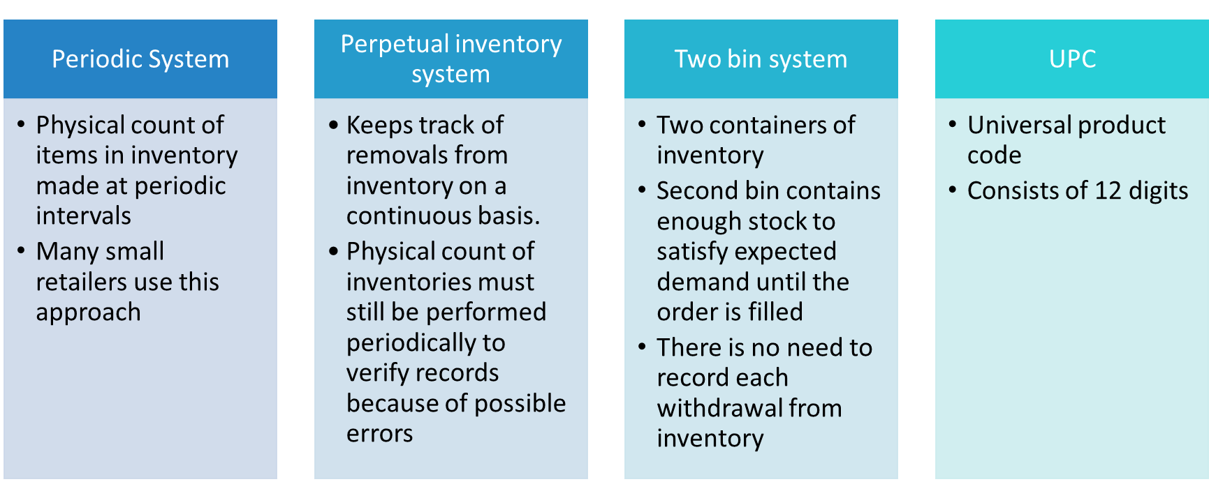
Inventory Counting System

Slide 7
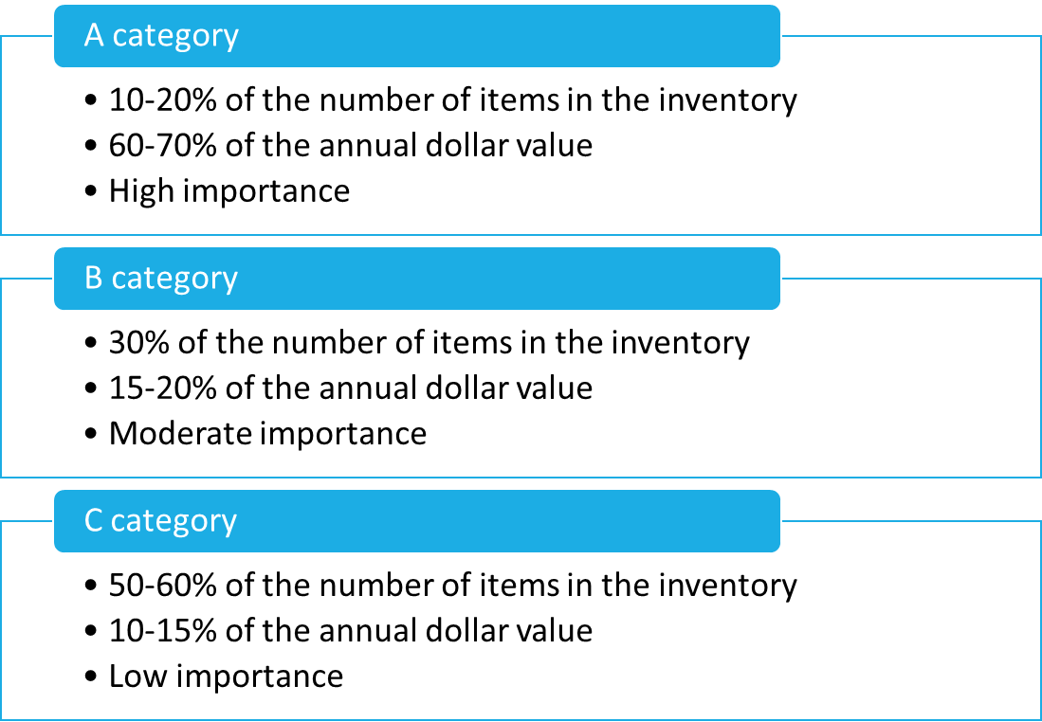
Inventory Classification System
ABC Approach

Slide 8
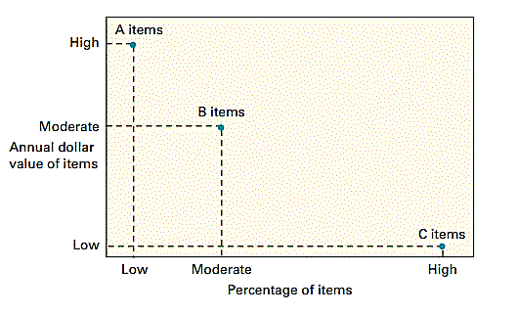
Fig: A-B-C Analysis

Slide 9

Inventory Costs
Four basic costs are associated with inventories:
Purchase cost
  amount paid to a vendor or supplier to buy the inventory
Holding, or carrying, costs
  costs include interest, insurance, taxes (in some states), depreciation, obsolescence, deterioration, spoilage, pilferage, breakage, tracking, picking, and warehousing costs
Ordering costs
  costs of ordering and receiving inventory
  expressed as a fixed dollar amount per order, regardless of order size
Setup costs
  expressed as a fixed charge per production run, regardless of the size of the run
Shortage costs
  Costs resulting when demand exceeds the supply of inventory

Slide 10

Inventory Ordering Policies
The basic economic order quantity model
The economic production quantity model
The quantity discount model

Slide 11
Assumptions of the basic EOQ model
Only one product is involved
Annual demand requirements are known
Demand is spread evenly throughout the year so that the demand rate is reasonably constant
Lead time is known and constant
Each order is received in a single delivery
There are no quantity discounts

Slide 12
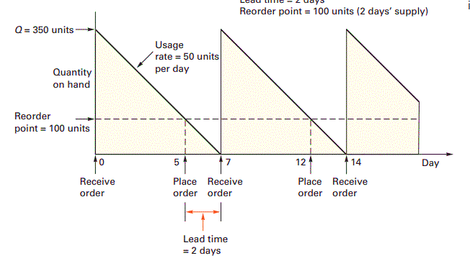
Fig: The inventory cycle: profile of inventory level over time

Slide 13
Question 1. A local distributor for a national tire company expects to sell approximately 9,600 steel-belted radial tires of a certain size and tread design next year. Annual carrying cost is $16 per tire, and ordering cost is $75. The distributor operates 288 days a year. Compute the optimal quantity and length of an order cycle
Question 2. Piddling Manufacturing assembles security monitors. It purchases 3,600 black-and-white
cathode ray tubes a year at $65 each. Ordering costs are $31, and annual carrying costs are 20 percent of the purchase price. Compute the optimal quantity and the total annual cost of
ordering and carrying the inventory.

Slide 14
Assumptions of the basic EPQ model
Only one product is involved
Annual demand requirements are known
The usage rate is constant
Usage occurs continually, but production occurs periodically
The production rate is constant
Lead time does not vary
There are no quantity discounts

Slide 15
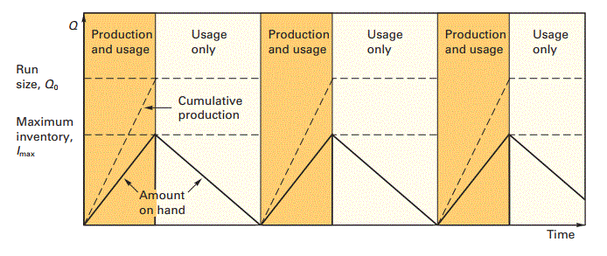
Fig: EOQ with incremental inventory buildup

Slide 16
Question 3. A toy manufacturer uses 48,000 rubber wheels per year for its popular dump truck series. The firm makes its own wheels, which it can produce at a rate of 800 per day. The toy trucks are assembled uniformly over the entire year. Carrying cost is $1 per wheel a year. Setup cost for production run of wheels is $45. The firm operates 240 days per year. Determine the
a. Optimal run size.
b. Minimum total annual cost for carrying and setup.
c. Cycle time for the optimal run size.
d. Run time.

Slide 17
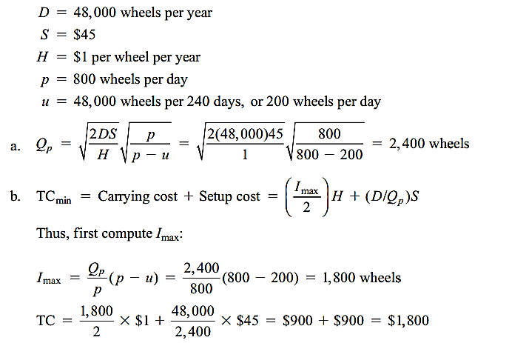

Slide 18
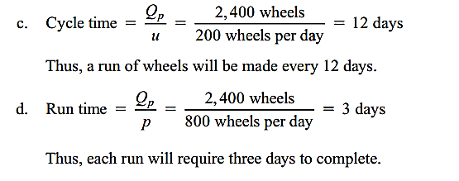

Slide 19
The quantity discount model
Quantity discounts are price reductions for larger orders offered to customers to induce them to buy in large quantities.
TC = Carrying cost + Ordering cost + Purchasing cost
= (Q/2)*H + (D/Q)*S + PD
P = Price per unit

Slide 20
Two Cases:
Carrying costs are constant
Carrying costs are specified as a percentage of unit price
The procedure for determining the overall EOQ differs slightly, depending on which of these two cases is relevant. For carrying costs that are constant, the procedure is as follows:
  1. Compute the common minimum point.
  2. Only one of the unit prices will have the minimum point in its feasible range since the
  ranges do not overlap. Identify that range.
    a. If the feasible minimum point is on the lowest price range, that is the optimal order
    quantity.
    b. If the feasible minimum point is in any other range, compute the total cost for the
    minimum point and for the price breaks of all lower unit costs. Compare the total
    costs; the quantity (minimum point or price break) that yields the lowest total cost is
    the optimal order quantity.

Slide 21
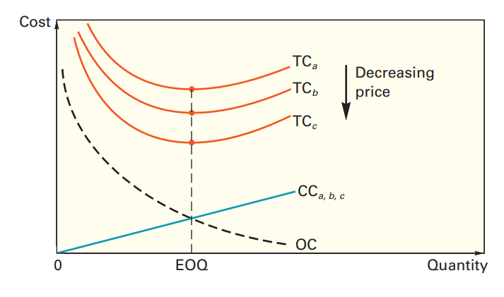
Fig: When carrying costs are constant, all curves have their minimum points at the same quantity

Slide 22
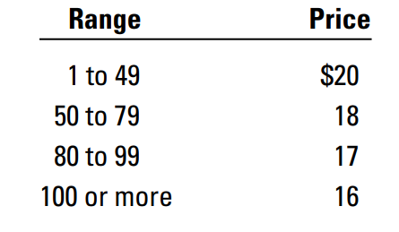
Question 4. The maintenance department of a large hospital uses about 816 cases of liquid cleanser annually. Ordering costs are $12, carrying costs are $4 per case a year, and the new price schedule indicates that orders of less than 50 cases will cost $20 per case, 50 to 79 cases will cost $18 per case, 80 to 99 cases will cost $17 per case, and larger orders will cost $16 per case. Determine the optimal order quantity and the total cost.

Slide 23

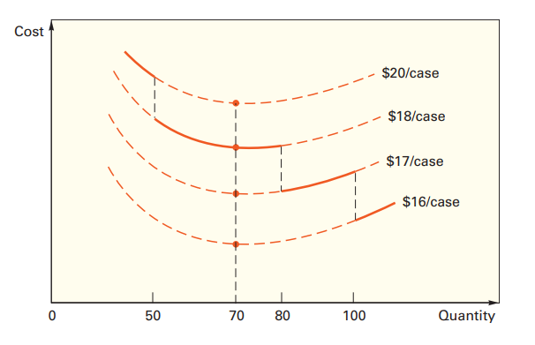

Slide 24
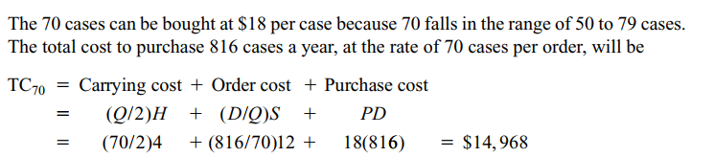
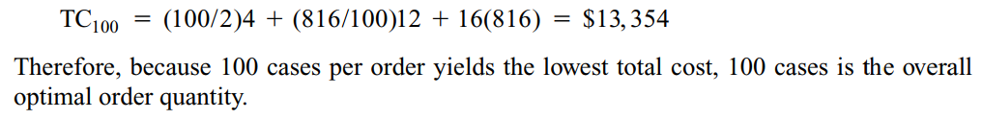

Slide 25
When carrying costs are expressed as a percentage of price, determine the best purchase
quantity with the following procedure:
  1. Beginning with the lowest unit price, compute the minimum points for each price range
  until you find a feasible minimum point (i.e., until a minimum point falls in the quantity
  range for its price).
  2. If the minimum point for the lowest unit price is feasible, it is the optimal order quantity.
  If the minimum point is not feasible in the lowest price range, compare the total cost at
  the price break for all lower prices with the total cost of the feasible minimum point. The
  quantity that yields the lowest total cost is the optimum.

Slide 26
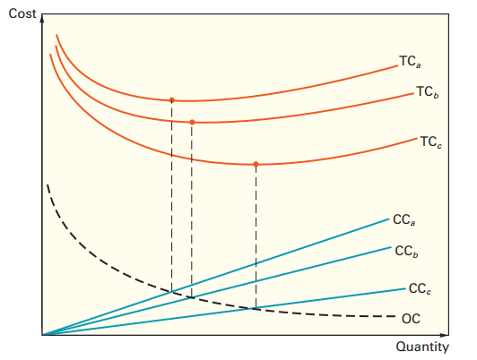
Fig: When carrying costs are stated as a percentage of unit price, the minimum points do not line up

Slide 27
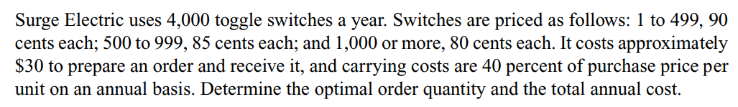
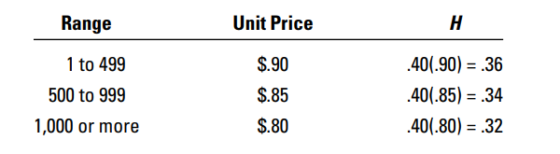

Slide 28
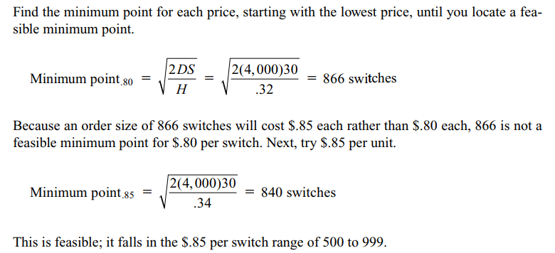

Slide 29
